Slide 1
ASSOTECH PRIDE – BHUBANESWAR PHASE – 1 CONSTRUCTION PROGRESS DETAIL – UPTO 30TH SEPTEMBER 2021

Slide 2
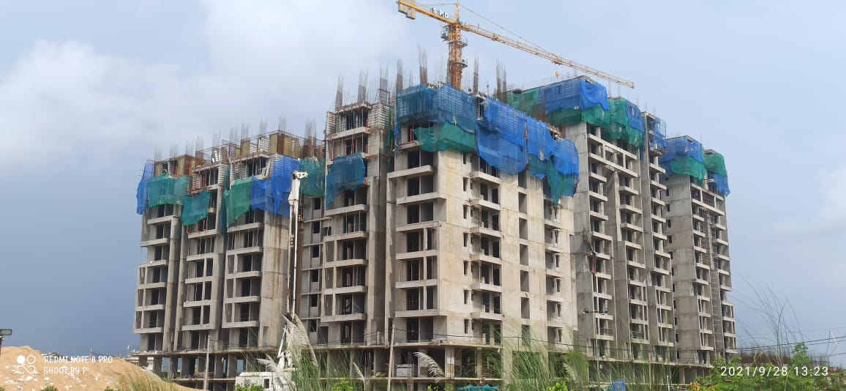
TOWER – B1 9TH FLOOR ROOF SLAB WORK IN PROGRESS

Slide 3
TOWER B2 - (TERRACE LEVEL SLAB COMPLETED)

Slide 4
TOWER – B2 MIVAN SHUTTERING

Slide 5
TOWER – B3 (1ST FLOOR ROOF SLAB WORK IN PROGRESS)

Slide 6
TOWER – B4 (STILT FLOOR ROOF SLAB COMPLETED)

Slide 7
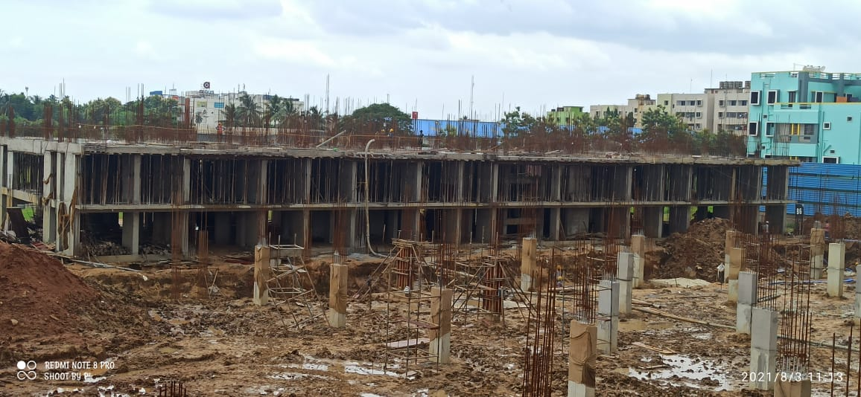
TOWER – B6 (STILT FLOOR ROOF SLAB COMPLETED)

Slide 8
TOWER – C1 (2ND FLOOR ROOF SLAB WORK IN PROGRESS)

Slide 9
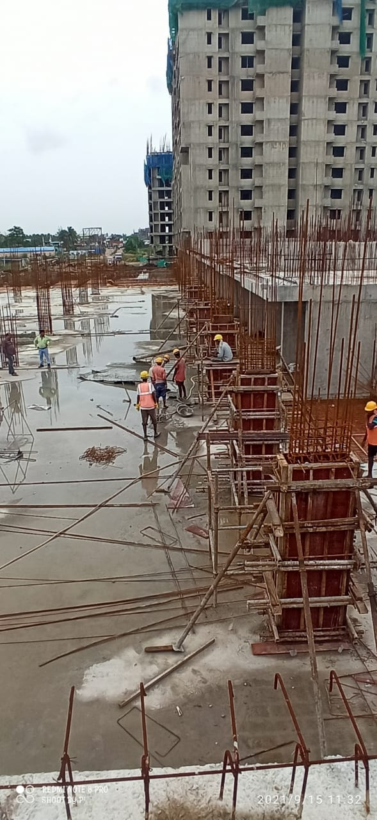
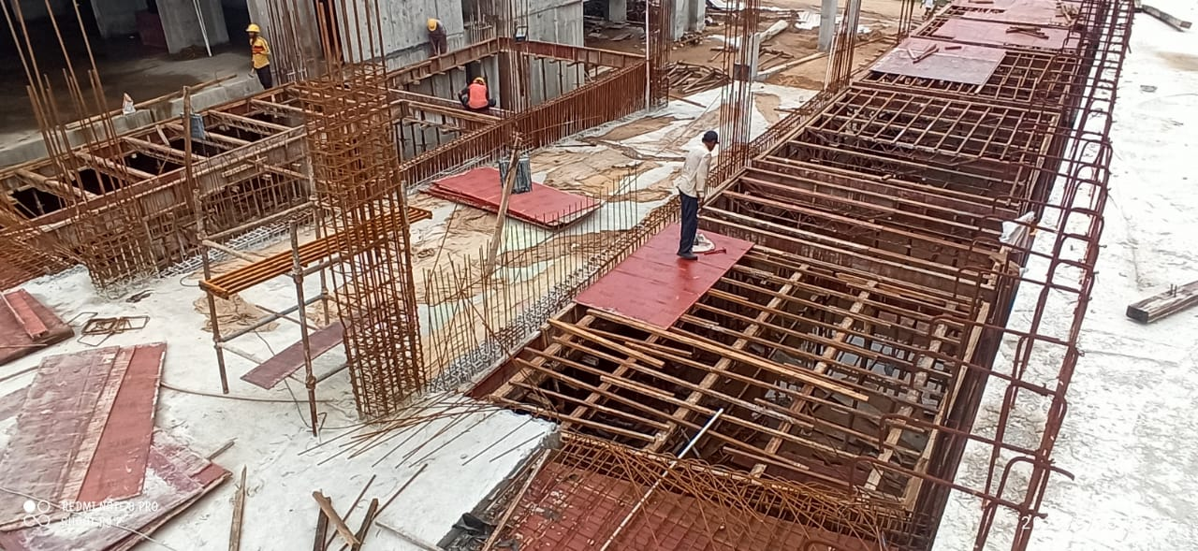
NON TOWER AREA – 1ST STILT ROOF SLAB IN PROGRESS

Slide 10
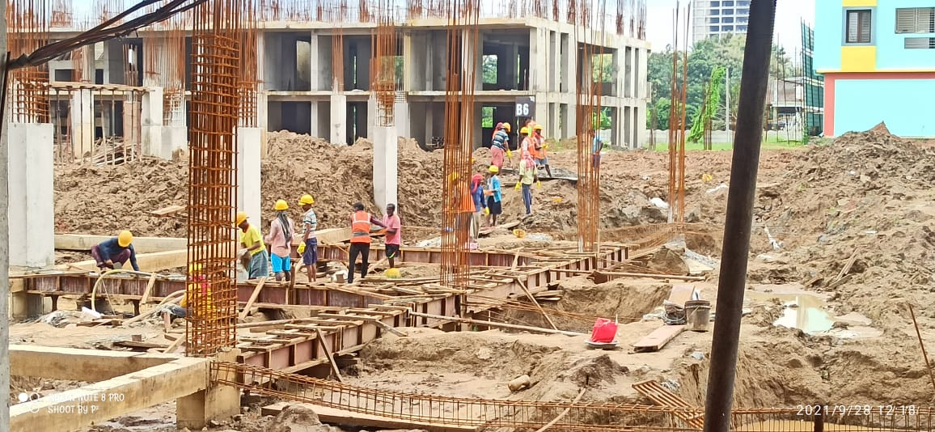
NON TOWER AREA – TIE BEAM WORK IN PROGRESS

